Slide 1
Tasks for Wednesday 2/22

Slide 2
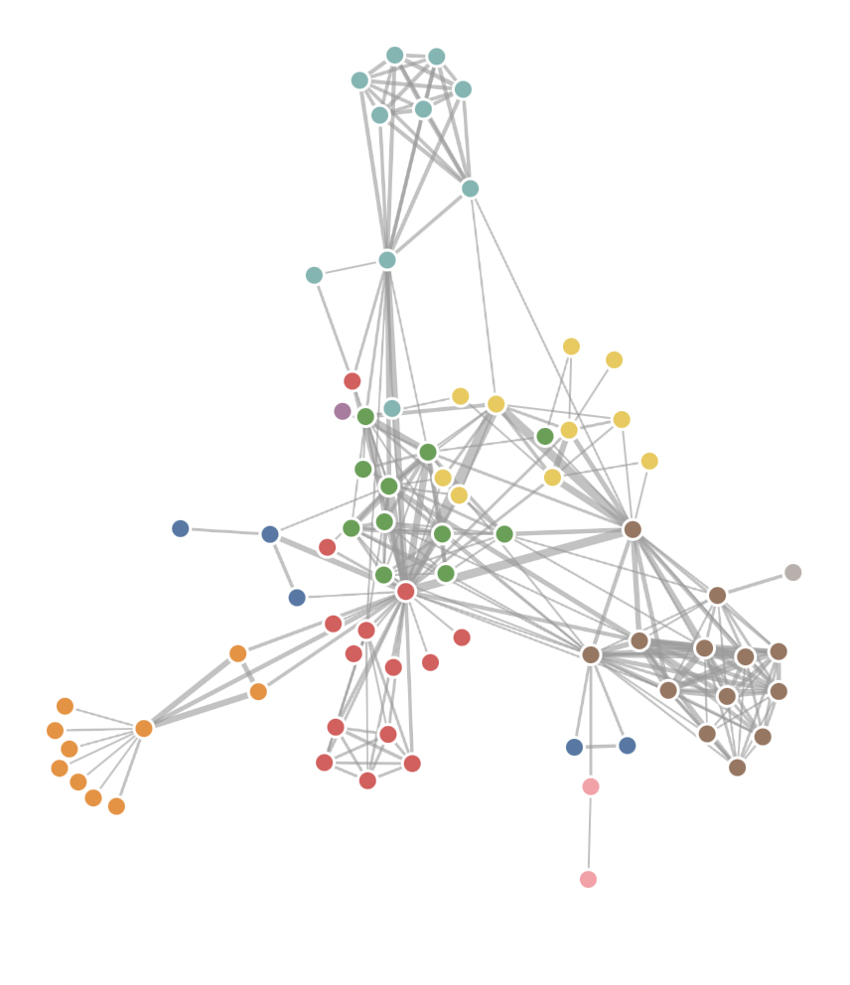
Client’s ask
Dr. Pienaar wants us to create a force directed graph
Steps to create this in ChRIS
Research how to create one
Port it to ChRIS ui code
Add styling
Research 3D rendering of it

Slide 3
Breakdown of Task
Iain
Understand ChRIS code and figure out how they are rendering the current node graph. Learn how to make changes and eventually add our force graph
Sohail
Research and create a force directed graph using JavaScript and a canvas so we can understand the algorithm. Use lookup and p5.js, it will make rendering easy
Yesh
Create a styling for a set of nodes / connecting lines using either a drawing program, or HTML / CSS. We can port your designs if you draw them.
Shen
Look into rendering a graph in 3D. I think Dr. Pienaar is expecting a molecule like render, so figure out how to use spheres and cylinders to draw H₂0 or something similar.

